Slide 1

Valentine’s Day Project
A CodeX Project with a Heart

Slide 2
Digital Valentines
Up your game this year by sending digital ❤️-filled messages and images to your friends.
Grab your CodeX device and some friends.
Then, let’s write some code!

Slide 3

First Steps
You will use CodeSpace for this project.
Go to make.firialabs.com
Log in (use your account or continue as a guest)
Go to the Sandbox
  Right side bar, near the bottom

Slide 4
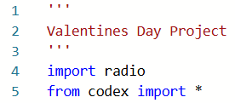
Can you hear me now?
For this Python project, you will need to import a couple modules:
Start a new file: valentines
In the text editor, start with importing libraries:

Slide 5
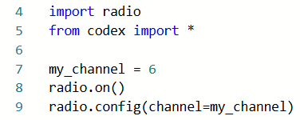
Can you hear me now?
You will send and receive valentines using a radio signal.
Turn on the radio and set the channel:

Slide 6
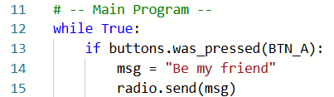
Can you hear me now?
In order to send and receive digital ❤️ messages continuously, use a loop.
If Button A is pressed, send a message.
Create your message – use your own text.

Slide 7

Can you hear me now?
Add code so CodeX will constantly listen for a signal.
If a signal is received, print it on the CodeX screen:

Slide 8
Can you hear me now?
Try it out!
Run the code.
Press BTN-A.
Everyone on your channel will receive your message.
You will receive their messages.
Full code on next slide.

Slide 9
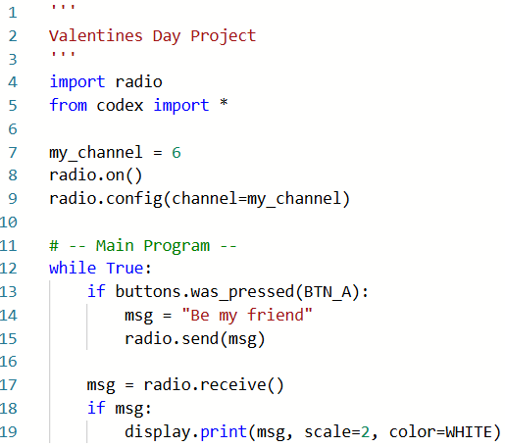

Slide 10
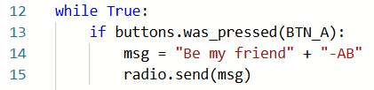
Make it personal
That is pretty cool, but you don’t know who is sending the message.
Add your initials to the message:

Slide 11
Make it personal
Let’s add some color.
All the messages don’t need to be WHITE.
Make a list of colors you want to use.
This list will go near the top of your code, just under the imports.
Remember to import the random library.
You will select a random color for each message you receive.

Slide 12
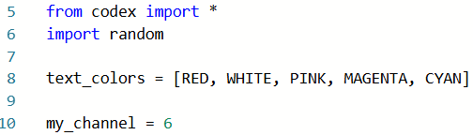
Make it personal
List as many colors as you want.
Here are the predefined colors you can choose from:
BLACK, BROWN, RED, ORANGE, YELLOW, GREEN, BLUE, PURPLE, GRAY, WHITE, CYAN, MAGENTA, PINK, LIGHT_GRAY, DARK_GREEN, DARK_BLUE

Slide 13
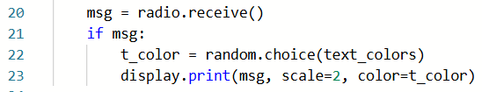
Make it personal
Add code to select a random color.
Use the color when printing the message.
The code is added to the if block.

Slide 14
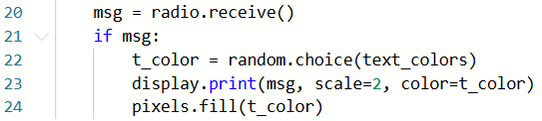
Make it personal
For even more fun, turn on the pixels every time you get a message.

Slide 15
Make it personal
Try it out!
Press BTN-A.
Everyone on your channel will receive your message.
You will receive their messages – in color!
Full code on the next slide.

Slide 16
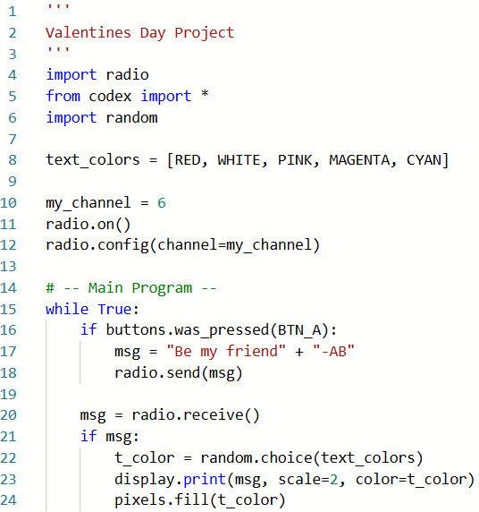

Slide 17

Mixed messages
Right now your message is always the same.
Mix it up with another list!
Think of short, uplifting messages you want to send to your friends.

Slide 18
Mixed messages
Create another list, just under the colors.
To make the list easier to read, you can put each message on a new line. Just be careful with the punctuation.
You can type as many messages as you want.
Example code on next slide.

Slide 19
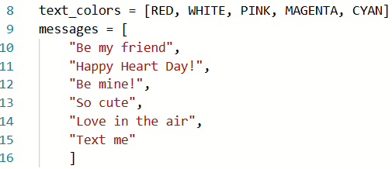
Mixed messages
Create another list, just under the colors.

Slide 20
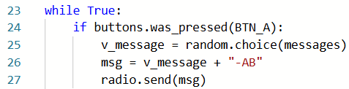
Mixed messages
When you send a message, choose one from the list:

Slide 21
Mixed messages
Try it out!
Press BTN-A.
Everyone on your channel will receive one of your random messages.
You will receive their messages – in color and with pixels on!

Slide 22
Steer clear
By now, your screen is filled with messages.
You may want to clear the screen occasionally.
You may even want to quit the program.
Add code for button presses that clear the screen and quit the program.
This code is in the main program’s while true loop.

Slide 23
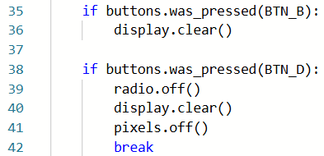
Steer clear

Slide 24
Steer clear
Try it!
Press BTN-A.
Everyone on your channel will receive one of your random messages.
You will receive their messages – in color and with pixels on!
Press BTN-B to clear your display screen.
Press BTN-D to quit.
Full code for the Main Program on the next slide:

Slide 25
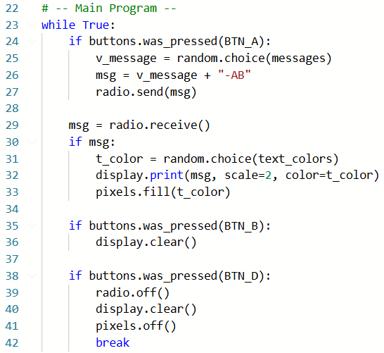

Slide 26
Add some ❤️
Enhance the ❤️-filled messages with some bitmap images of ❤️s!
First you need to add a bitmap heart image to the code.
Copy the code on the next slide and paste it into your code just below the radio commands.

Slide 27
Add some ❤️
small_heart = '''
/0=WHITE 2=RED .=TRANSPARENT
.......000....000.......
......02220..02220......
......022220022220......
.....02222222222220.....
.....02222222222220.....
.....02222222222220.....
.....02222222222220.....
......022222222220......
......022222222220......
.......0222222220.......
........02222220........
.........022220.........
..........0220..........
...........00...........
'''
Copy and paste this code into your program.
It should be placed just above the Main Program.

Slide 28
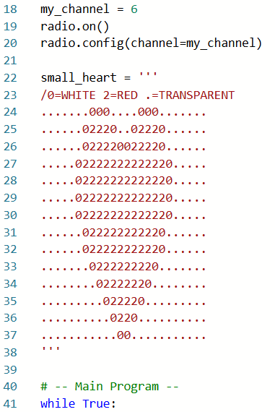
Add some ❤️
Your code should look like this:

Slide 29

Add some ❤️
Add code so that a ❤️ appears randomly on the screen whenever you receive a heart.
First import a new library:

Slide 30
Add some ❤️
Add this code to the if msg: block
First get random numbers for the location
(x and y) of the heart on the screen.
Then use those numbers to display the bitmap heart image.
Code on the next slide:

Slide 31
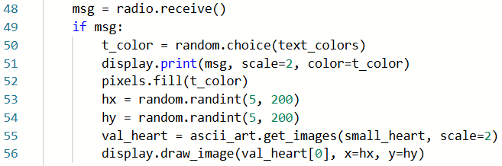
Add some ❤️

Slide 32
Final touch
When your program starts, it is just a blank screen.
Add a short menu that lets you know what buttons to press, and what they do.
This will go in your Main Program, just above the while loop.

Slide 33
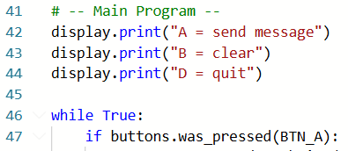
Final touch
Add a short menu that lets you know what buttons to press, and what they do.

Slide 34
Try it! ❤️
Run your code.
Have fun sending and receiving some ❤️-filled messages with your friends!

